Slide 1
bEquality
Trustful, reliable and efficient platform to further enhance gender-equality
Lena Csomor, Qianchen Yu, Noah Berner, Eric Léger, Matthias Matti, Lino Telschow, Fredin Thazhathukunnel, Roy Schubiger
Notes:
Welcome
Challenge description
Goal: Automate process, reliable, transparent, …
…index withing a much shorter AMOUNT OF TIME. !!!

Slide 3
Gender equality challenge by UBS
Employer
company - data capture - data verification - evaluation
Notes:
Necessary steps for companies to get the INDEX !!!!

Slide 4
Gender equality challenge by UBS
data
survey
Employer
company - data capture - data verification - evaluation

Slide 5
Gender equality challenge by UBS
employer
provided data
data
survey
Employer
employee
survey
company - data capture - data verification - evaluation
Notes:
Send data -> employer provided
Set up employee survey -> APP !!!

Slide 6

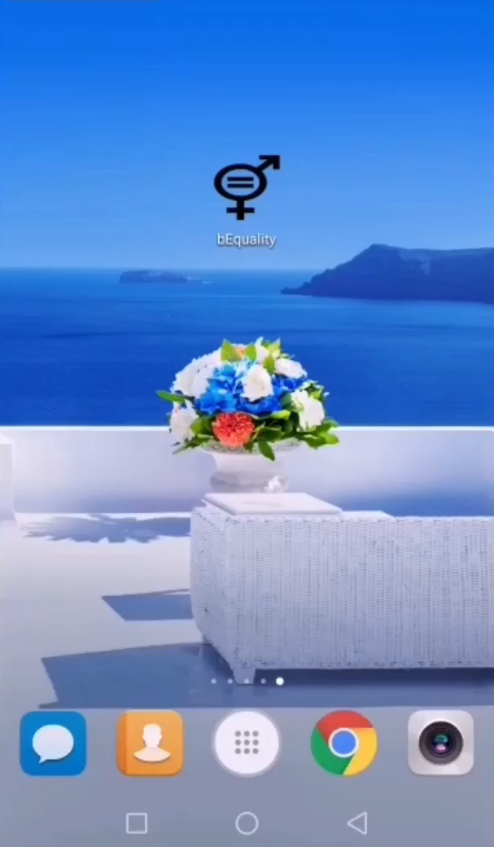
Gender equality challenge by UBS
employee survey
E-voting system
company - data capture - data verification - evaluation
Notes:
Mock survey
Based on existing surveys
User creates pw and acc
Fully automated
… to our employees, i’m sure your ALL WONDERING WHAT’S below surface !!!! (animation)
… NOAH WILL PRESENT SHORTLY !!!

Slide 7
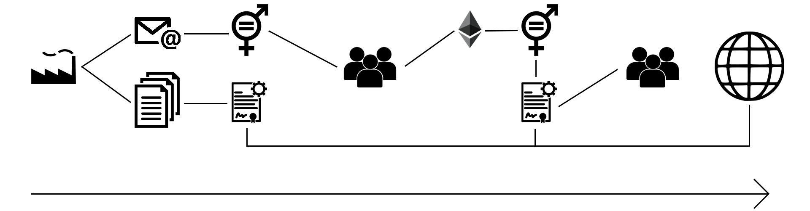
Gender equality challenge by UBS
E-voting system
company - data capture - data verification - evaluation
Notes:
… (just click when finished) …

Slide 8
Gender equality challenge by UBS
employer
provided data
data
survey
Data verification
employee
survey
company - data capture - data verification - evaluation
Notes:
… data sets are BEING COMPARED TO ENSURE VALIDITY !!! (animation)
Guarantee fair rating
Automated rating
CLICK !!!

Slide 9
Gender equality challenge by UBS
employer
provided data
Data verification
evaluation
employee
survey
company - data capture - data verification - evaluation
Notes:
Similar way like existing ratings
… WE IMPROVE IT! (get spider diagram)

Slide 10
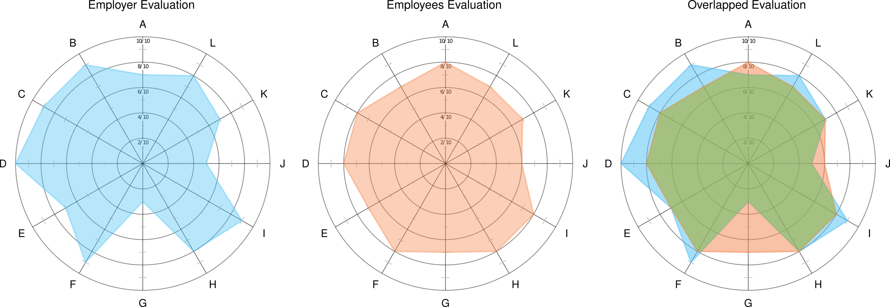
Gender equality challenge by UBS
evaluation
company - data capture - data verification - evaluation
Notes:
Evaluation
Flexible system
Detailed feedback
Improve current system

Slide 11
Gender equality challenge by UBS
website prototype
INSERT WEBSITE LINK
company - data capture - data verification - evaluation

Slide 12
QUESTIONS?

Slide 13
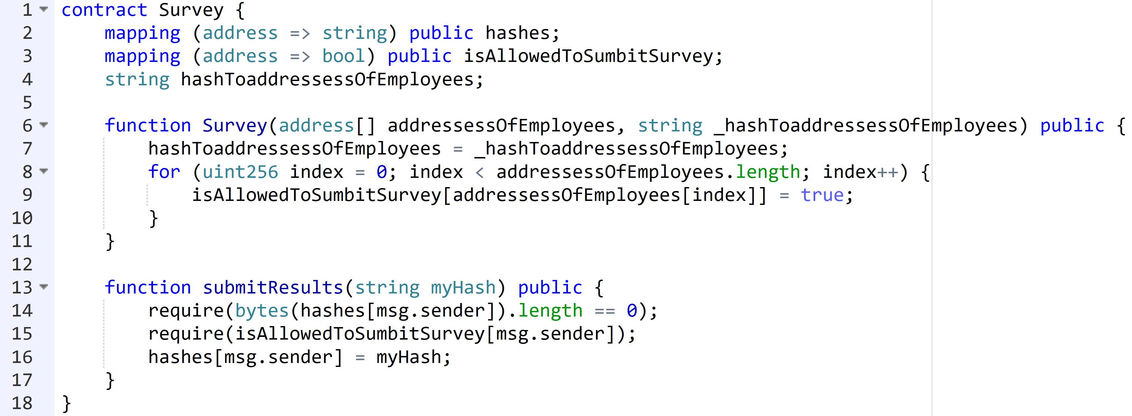
Survey smart contract

Slide 14
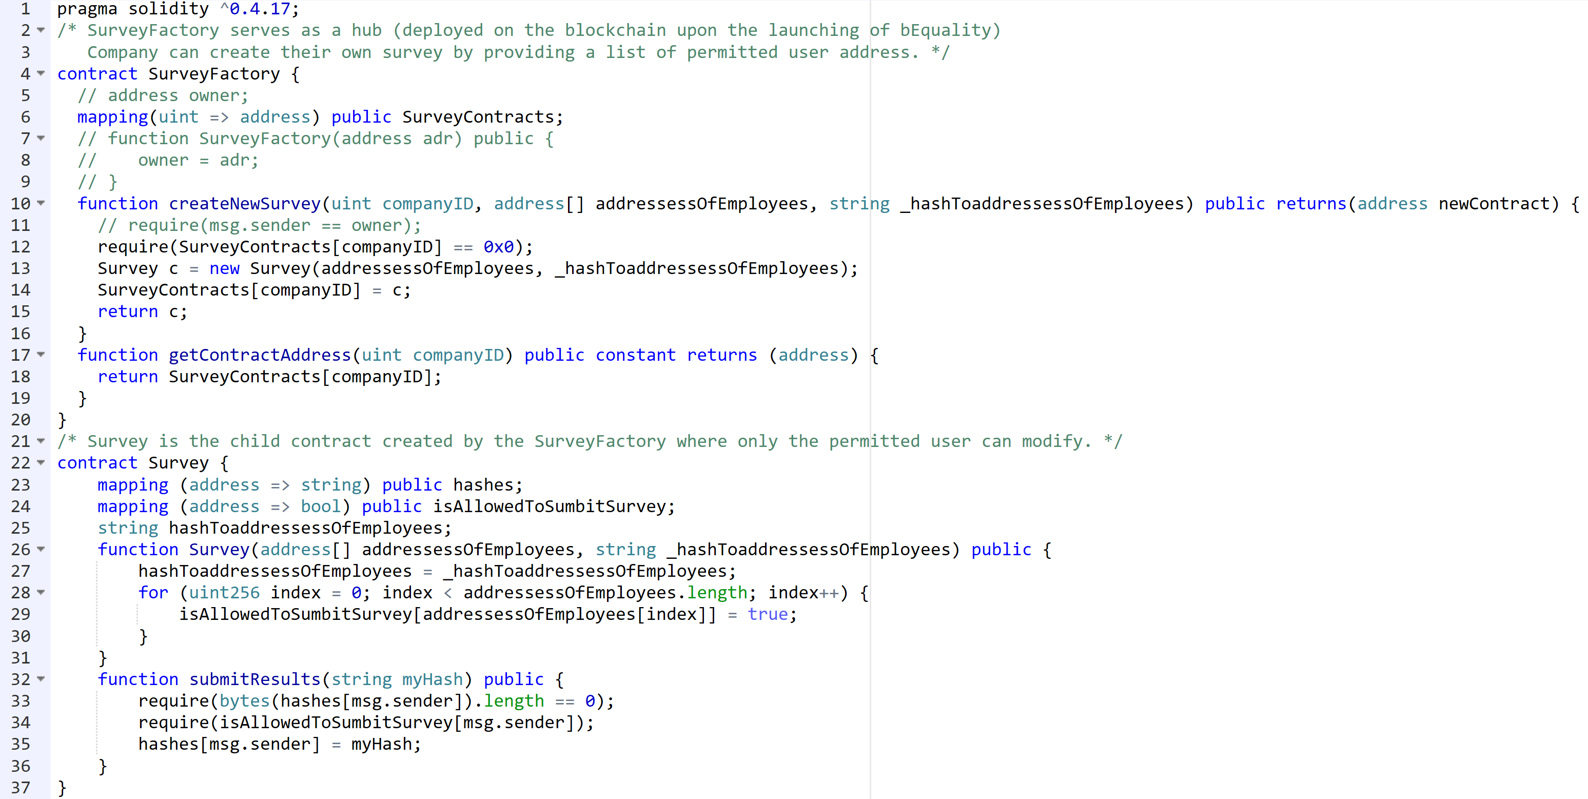
All smart contracts

Slide 15
Secure login data storage
user
DataBase
username
password
username
hashed password
hash
hash(password + key)
private key
hashed key

